Slide 1
Capstone Project The Battle of Neighborhoods | Finding a Better Place in Scarborough, Toronto

Slide 2
Introduction
Project is to help people in exploring better facilities around their neighbourhood
making smart and efficient decision on selecting great neighbourhood
ease of accessing to Cafe, School, Super market, medical shops, grocery shops, mall, theatre, hospital, like minded people, etc
The features include median housing price and better school according to ratings, crime rates of that particular area, road connectivity, weather conditions, good management for emergency, water resources both freash and waste water and excrement conveyed in sewers and recreational facilities
It will help people to get awareness of the area and neighbourhood before moving to a new city, state, country or place for their work or to start a new fresh life.

Slide 3
Data Section
Data Link: https://en.wikipedia.org/wiki/List_of_postal_codes_of_Canada:_M
The data retrieved from Foursquare contained information of venues within a specified distance of the longitude and latitude of the postcodes. The information obtained per venue as follows:
1. Neighbourhood
2. Neighbourhood Latitude
3. Neighbourhood Longitude
4. Venue
5. Name of the venue e.g. the name of a store or restaurant
6. Venue Latitude
7. Venue Longitude
8. Venue Category

Slide 4
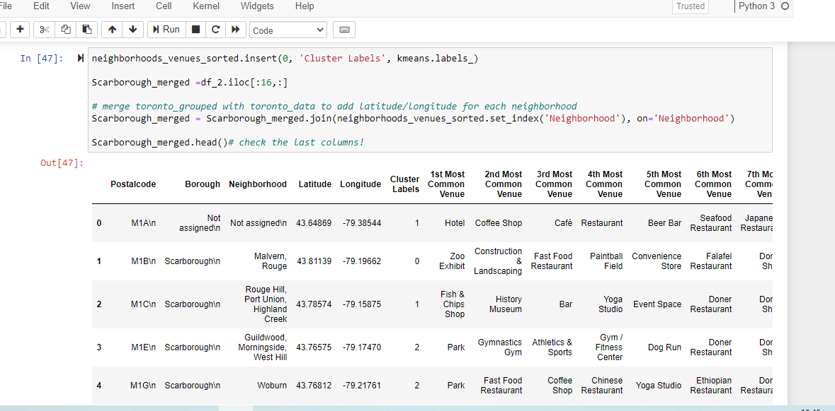
Methodology
Using K-Means Clustering Approach

Slide 5
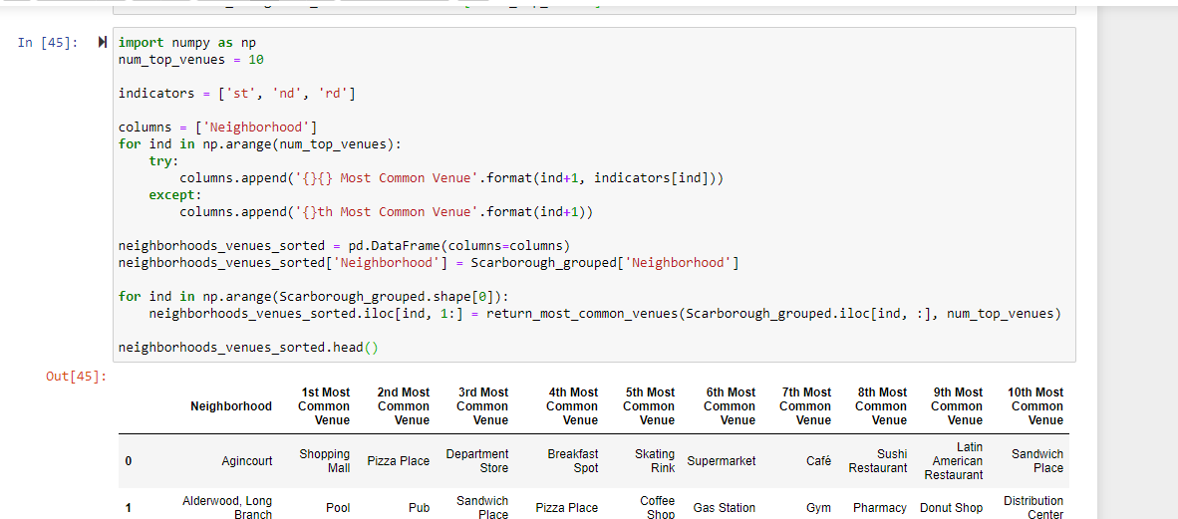
Methodology
Most Common venues near Neighbourhood

Slide 6
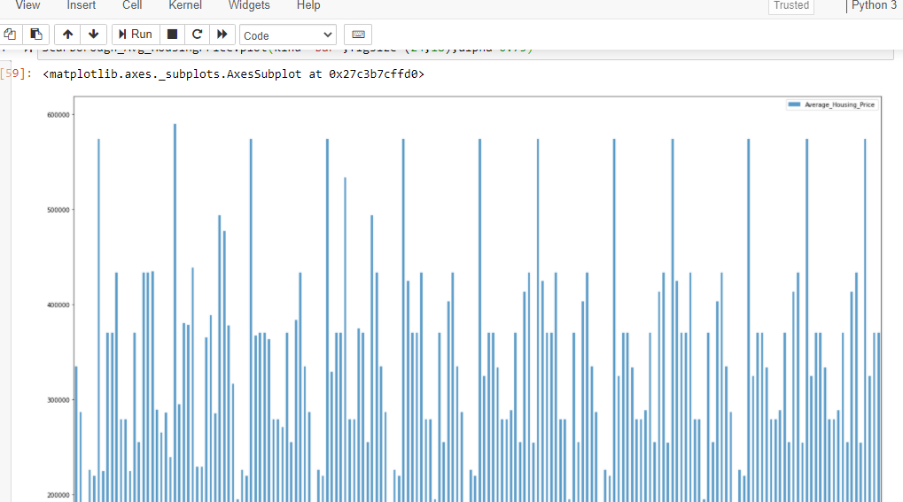
Results
Average Housing Price by Clusters in Scarborough

Slide 7
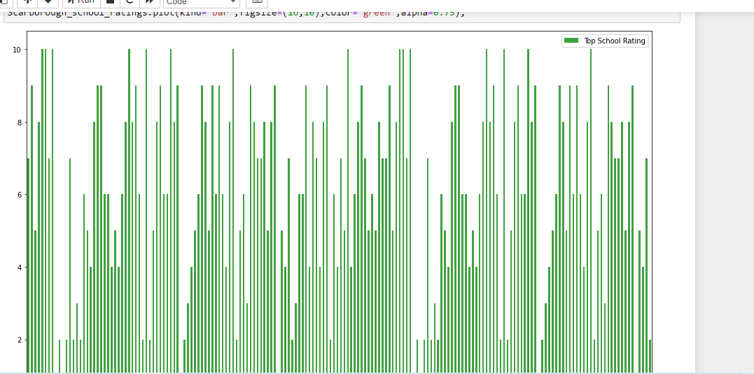
Results
School Ratings by Clusters in Scarborough

